Slide 1
Correction Formulas for Optical Aerosol Particle Variables
Alfred Wiedensohler
Director ACTRIS CAIS-ECAC

Slide 2
Integrating Nephelometer

Slide 3

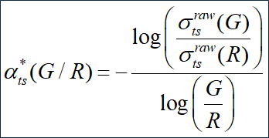

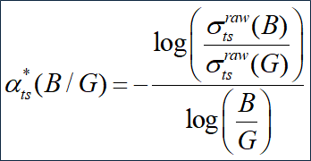


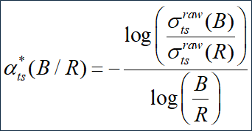

Correction for Angular Non-Idealities & Truncation
The truncation correction should be performed using the Ångström exponents, following the equations below (Müller et al.; 2011; Anderson and Ogren, 1998).

Slide 4
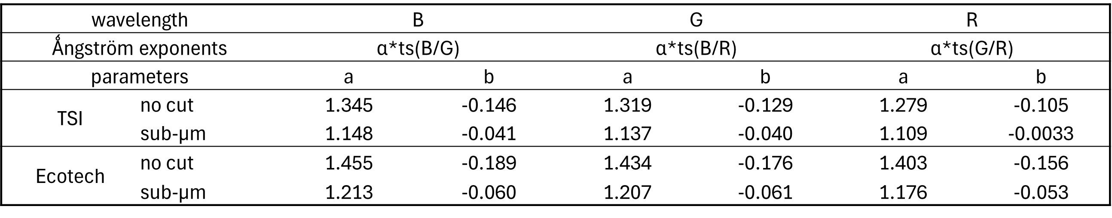
Correction for Angular Non-Idealities & Truncation
Correction factors for total particle light scattering coefficients as function of the Ångström exponents from Müller et al. (2011) The Ecotech factors can be employed for Aurora 3000 & 4000 as well as for NE-300 & NE-400 with neglectable uncertainties.
Correction factors for backscattering coefficient accounting for the angular non-idealities in TSI (450, 550, and 700 nm) and Ecotech (450, 525, and 635 nm) integrating nephelometers.
Wavelength | B | G | R
TSI no cut | 0.984 +/- 0.041 | 0.984 +/- 0.041 | 0.988 +/- 0.043
TSI sub-um | 0.950 +/- 0.009 | 0.944 +/- 0.012 | 0.954 +/- 0.009
Ecotech no cut | 0.963 +/- 0.040 | 0.971 +/- 0.047 | 0.968 +/- 0.043
Ecotech sub-um | 0.932 +/- 0.012 | 0.935 +/- 0.017 | 0.935 +/- 0.014

Slide 5
Absorption Photometer
MAAP

Slide 6


Correction to Determine the Absorption Coefficient and Mass Concentration of eBC (MAAP)
For the absorption coefficient, only a wavelength correction needs to be applied, as the actual operating wavelength of the MAAP is 637 nm. The particle light absorption coefficient and eBC mass concentration derived from MAAP measurements can be calculated as follows:

Slide 7
Absorption Photometer
AE33/36

Slide 8
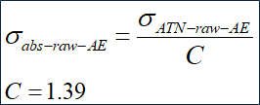



Correction to Determine the Absorption Coefficient and Mass Concentration of eBC (AE33 & 36)
The wavelength-dependent mass absorption cross-sections (MAC) provided by the Aethalometer 33/36 are as follows: MAC(λ) [m2/g]: 18.47 (370 nm), 15.54 (470 nm), 13.14 (520 nm), 11.58 (590 nm), 10.35 (660 nm), 7.77 (880 nm), and 7.19 (950 nm). The internal C value for the latest recommended filter tape is 1.39 (M8060).
In ACTRIS, a harmonization factor H* of 1.76 was determined based on long-term parallel measurements by the ratio of particle light absorption coefficients of the Aethalometer AE33 to those of the MAAP (ACTRIS report: Müller & Fiebig; 2021).
The wavelength-dependent harmonized particle light absorption coefficient and equivalent black carbon (eBC) mass concentration at 880 nm can be determined as follows:

